Slide 1
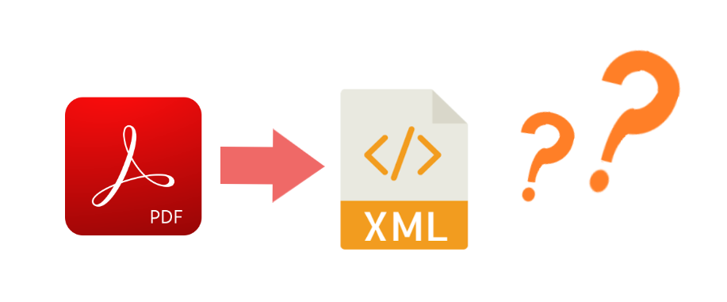
Index Extraction From Textbooks
KOM Lab Design Workshop – Group KM-2
Yujin Wang Ruolin Huang Fabian Rösch
guantao0815@gmail.com hrl96fz@foxmail.com fabianroesch@gmail.com Tim Steuer

Slide 2
Our Project: Index Extraction From Textbooks
Motivation
Index of a book can contain information about its contents that can be analyzed
If Index can be extracted it can be used for keyword extraction or algorithmic paragraph headline creation
Problem
Most Textbooks are PDF
PDF is not well structured and thus can not easily be interpreted by a machine
Idea
It’s difficult for a machine to read and contextualize the content of a PDF file
XML is well structured with labels
Solution
Automate index extraction from PDF files to standardized XML files

Slide 3
Existing Related Projects and Services
Amazon Textract | AWS cloud based service to extract data from scanned documents using machine learning Made for scanned documents that do not contain actual text Expensive and not open source
Apache Tika | Java based toolkit to parse PDF Documents and it‘s metadata and extract into HTML format extraction Powerful toolset
PDFBox | Open Source Java Library Powerful toolset Well documented and integrated into Java

Slide 4
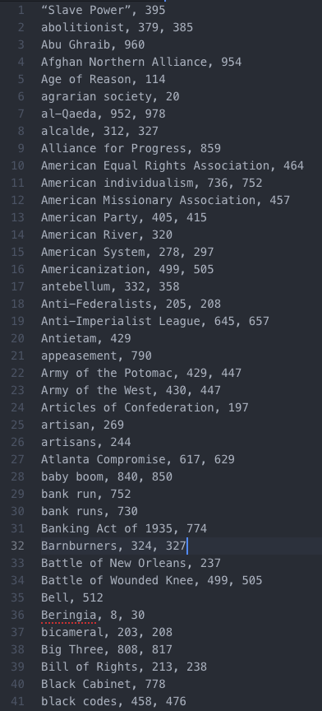
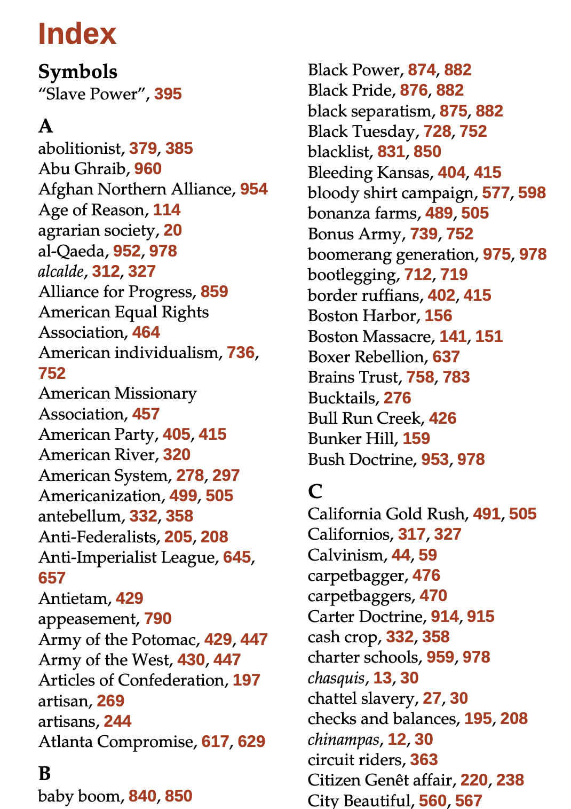
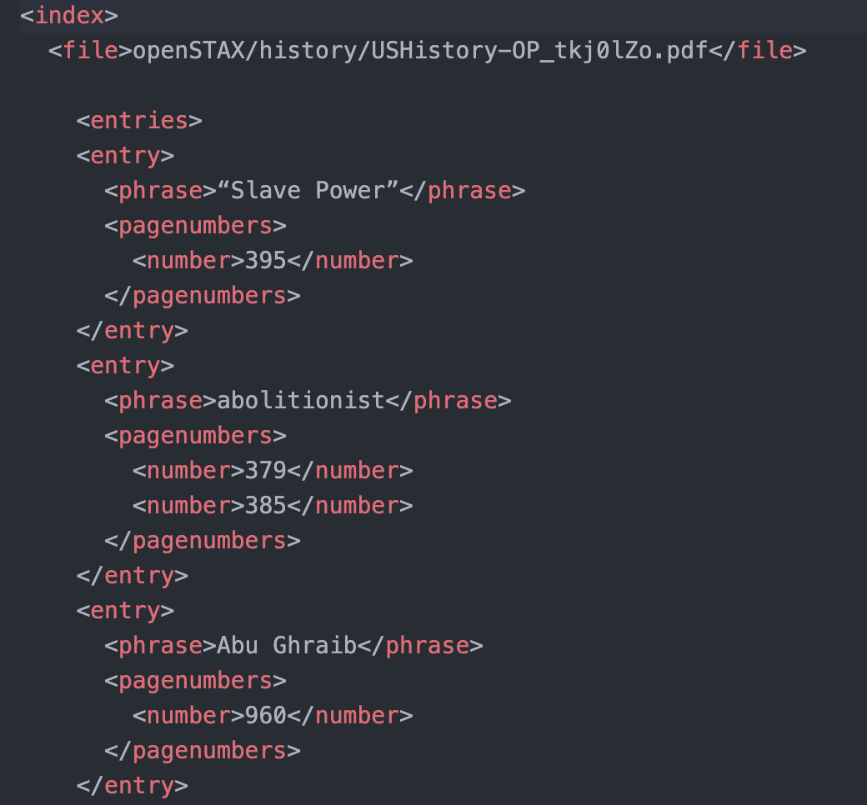
Implementation Idea: Intermediate Format
Step 1
Step 2
U. S. History [1]
Notes:
Intermediate Format to easier work with in java → String

Slide 5
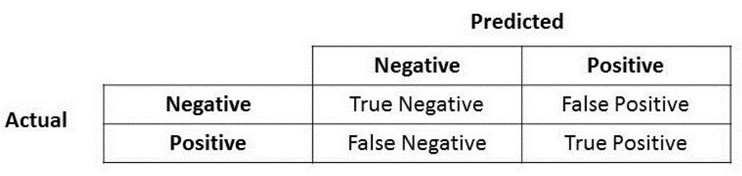
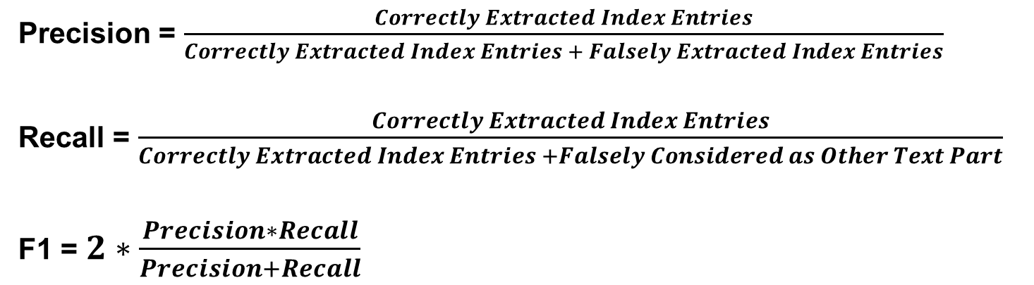
Evaluation Method: Precision, Recall and F1 Metric
Precision = $\frac{Correctly Extracted Index Entries}{Correctly Extracted Index Entries + Falsely Extracted Index Entries}$
Recall = $\frac{Correctly Extracted Index Entries}{Correctly Extracted Index Entries +Falsely Considered as Other Text Part}$
F1 = $2∗\frac{Precision∗Recall}{Precision+Recall}$
Accuracy, Precision, Recall or F1?[2]
Notes:
Intermediate Format to easier work with in java → String

Slide 6
Status Quo
Golden Standard
Five manually created sample XML files for verification and testing
Programming language and library
Java
PDFBox library
Raw text extraction
Raw PDF to TXT extraction including all undesired content
Basic filtering of undesired content and separating phrases from page numbers
Performs well in one PDF but it still need to be optimized for general using
Notes:
Java for ease of use and most experience in team
Pdfbox because of extraction method in easier to work with txt format
Golden standard for testing and determining accuracy
First steps are to extract the index with all undesired conctents and then filter that out

Slide 7
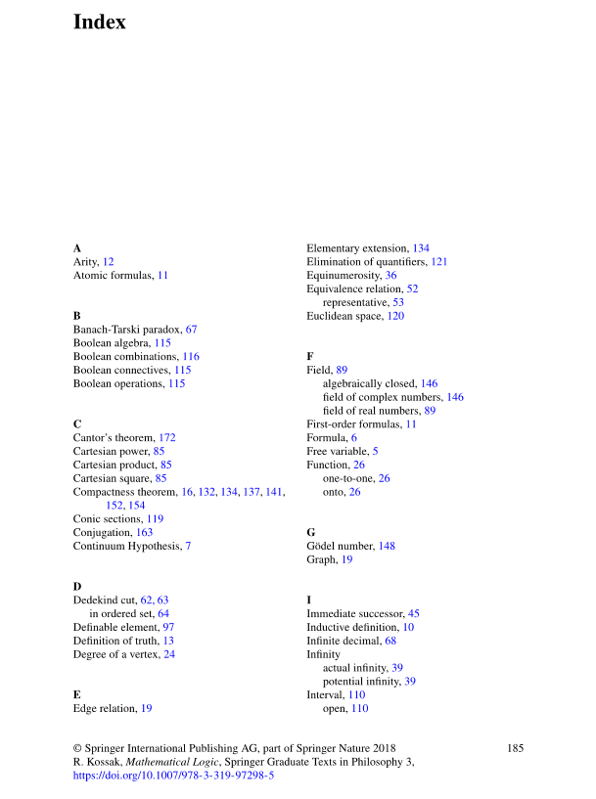
Main Obstacles Right Now
Determining where the Index in any given PDF is
Filtering and removal of non-relevant content (e.g. page number, header, etc)
How to identify subphrases
Headlines
These are not individual entries but subentries
Header/Footer
Pagenumber
Automata and Computability [3]
Notes:
Hello, this is Fabian Rösch
As Ruolin explained the basic functionality of our extractor is working but we are still tackling some major obstacles
Firstly, as you have just seen curently we are manually inserting the page range of the Index. While this could be done via a json config for every book our goal is to automate the process as much as possible. To solve this we want to utilize a text classifier to identify index pages in contrast to the rest of the book,
The next two issues are founded in the extraction of information from the pdf files. First our current method extracts just the plain text content of the pdf file including footer, header, pagenumber and content that does not concern us like headlines
Secondly there might be subphrases to an entry like in this example we want to extract algebraically closed Field instead of algebrabraically closed as an individual entry.
This also entails more issues as there are different subentries that either precede or succeed the parent phrase. Also as seen in the given example the parent phrase could still be in the subphrase
To solve these problems we are evaluating more versatile methods of extraction and might switch from txt to another intermediate format like xhtml/xhtml which includes some more information like paragraph labels
while these are our current strategies we are very much open for suggestions to different and maybe better solutions and are eager to read your feedback.

Slide 8
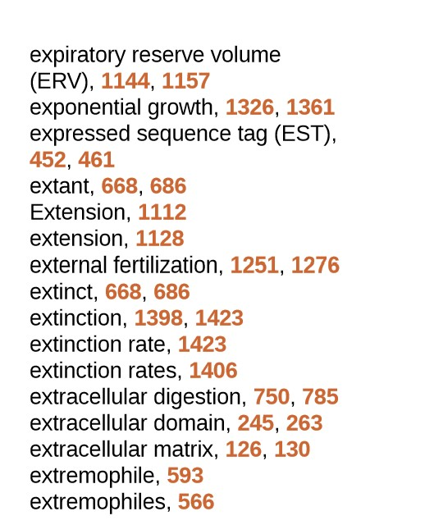
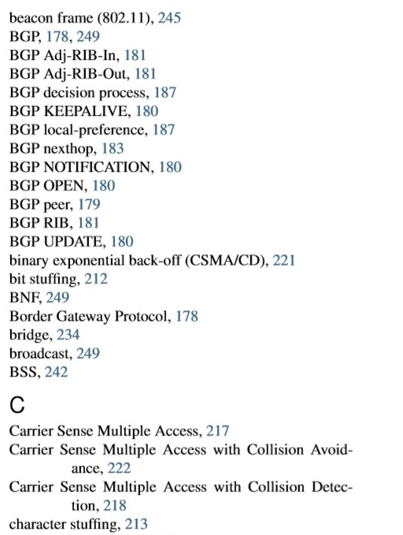
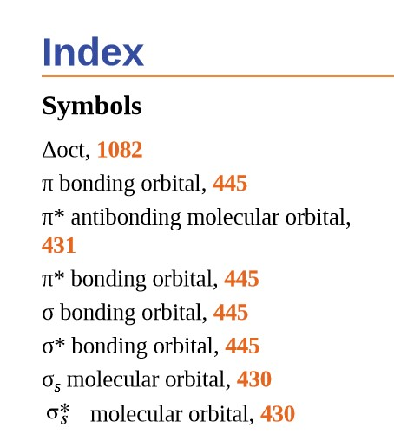
Further Problems: Special Cases
Some special symbols
The phrase is too long and split into two lines
How to distinguish between the hyphen existing in the phrase itself and the hyphen due to line breaks
Line break due to long entrys
special symbols
hyphens due to line breaks
Chemistry-OP [4]
Biology-OP[5]
Computer-Networking-Principles-Bonaventure-1-30-31-OTC1 [6]
Notes:
besides the main obstacles there are some special scenarios where the extraction might not work properly and we want to solve a little further down the line after the main issues are ironed out
Some are shown here:
Special non standard symbols like for example greek symbols used in mathematics are not extracted as these symbols but weird combinations of standard latin letters and symbols like for example alpha might be extracted as o-apostrophy
Also Currrently we are expecting each entry to be in one line which gets messed up whenever one entry expands to a second line due to its length
Related to that when the entry expands to a second line and is divided mid word with a hyphen we would like to remove that hyphen and have the correct word extracted
Again we are very happy to hear your feedback and ideas on these issues.
Thank you for your time!

Slide 9
Sources
[1] Corbett, P. S., Volker, J., Lund, J. M., Pfannestiel, T., Vickery, P. S., & Janssen, V. (2014). U. S. History. Amsterdam, Niederlande: Amsterdam University Press.
[2] Koo Ping Shung, (Mar 15, 2018) Accuracy, Precision, Recall or F1? https://towardsdatascience.com/accuracy-precision-recall-or-f1-331fb37c5cb9
[3] Kozen, D. C. (2013). Automata and Computability. New York, Vereinigte Staaten: Springer Publishing.
[4] Flowers, P., Theopold, K., Langley, R., STEPHEN F., ROBINSON, W. R. (2015). Chemistry-OP. Rice University Press
[5] RYE, C., WISE, R., JURUKOVSKI, V., DESAIX, J., CHOI, J., AVISSAR, Y. (2013). Biology-OP. Rice University Press
[6] Olivier Bonaventure (October 30, 2011) Computer-Networking-Principles-Bonaventure-1-30-31-OTC1.

